Slide 1
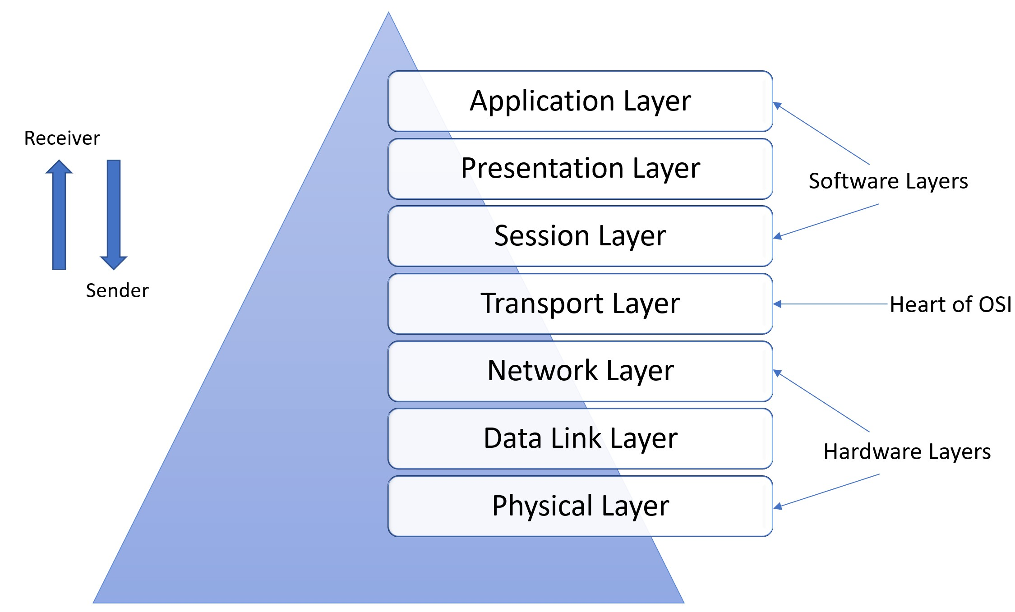
OSI Model
USA Charities
By: James Harris, Anika Bravo, Jayden Trujillo, Zack Parman, Matthew Orsini, & Elijah Lawrence

Slide 2
History OSI Model
The OSI Model was first developed in 1978 by Hubert Zimmermann.
A refined but still draft stage OSI model was published in 1980.
It was adopted by major computer and telecommunication companies in 1984.
The OSI Model provides a standardized framework for understanding and discussing networking concepts.

Slide 3
What is the OSI Model?
The OSI (Open Systems Interconnection) Model consists of seven layers of networking studies.
It helps us categorize everything that happens in a network so if a problem were to occur, troubleshooting is a lot easier when a problem can be distinguished by what layer it resides in.
However, not everything will perfectly fit into the model. It should purely be used as a reference.

Slide 4
Physical
The lowest layer of the OSI model that is responsible for the physical transmission of data bits through a medium is the Physical layer.
Examples: Ethernet cables, fiber optic cables, network interface cards, RJ45 connectors.
Received signals are converted into binary data then sent to the Data Link layer.
Functions: Bit synchronization, bit rate control, physical topologies, and transmission mode

Slide 5
Data Link
It is responsible for organizing bits from the Physical Layer into frames and ensures error-free data transfers from one node to another.
Switch & bridge are Data Link Layer devices.
MAC address occupy this layer.
Functions: framing, physical addressing, error control, flow control, and access control.

Slide 6
Network
The network layer is responsible for the interconnection of different networks through sending data packets back and forth.
It forwards packets from the source to the destination host.
It routes packets using the most optimal path to reach the destination.
In addition, IP addresses are assigned at this layer.
The devices in this layer are- layer 3 switches, firewalls, and routers

Slide 7
Transport
The transport layer is responsible for delivery.
Uses either TCP or UDP for transmission.
When using TCP it sends ACK(acknowledgement) of reliable delivery.
Breaks down the data into smaller units called segments and reassembles them at the destination.

Slide 8
Session
The session layer allows you establish and terminate a connection between devices.
This layer manages and ensures that the communication between devices transmitted and received without complication.
Synchronization helps the data stream remain constant so that if the data transfer drops it will create special points that indicate if the session can resume

Slide 9
Presentation
This is also known as the Translation layer.
The application layer's data is withdrawn and utilized by translating, encrypting, and compressing it into the needed presentation to transfer over the network.
A function of the presentation layer is it translates codes (ASCII to Unicode)

Slide 10
Application
The application layer is the topmost layer of the OSI model and serves as the interface between the end-user and the network.
Role: Ensures that data is presented in a readable format and manages how data is sent and received.
Functions: Facilitates communication between software applications and lower layers of the OSI model.
Examples: File transfers, emails, web browsing, as well as remote access.
Protocols: The protocols often found at this layer are HTTP, FTP, SMTP, and DNS.

Slide 11

Links
https://iotdunia.com/7-end-to-end-layers-in-osi-model/
https://www.perimeter81.com/glossary/osi-model#:~:text=First%20developed%20in%201978%20by,ISO%2FIEC%207498%E2%80%931.
https://www.techtarget.com/searchnetworking/definition/Application-layer#:~:text=The%20application%20layer%20sits%20at,layer%20is%20not%20an%20application.
Copilot

